Slide 1
Calculus Horiba XploRA Plus Method Development

Slide 2
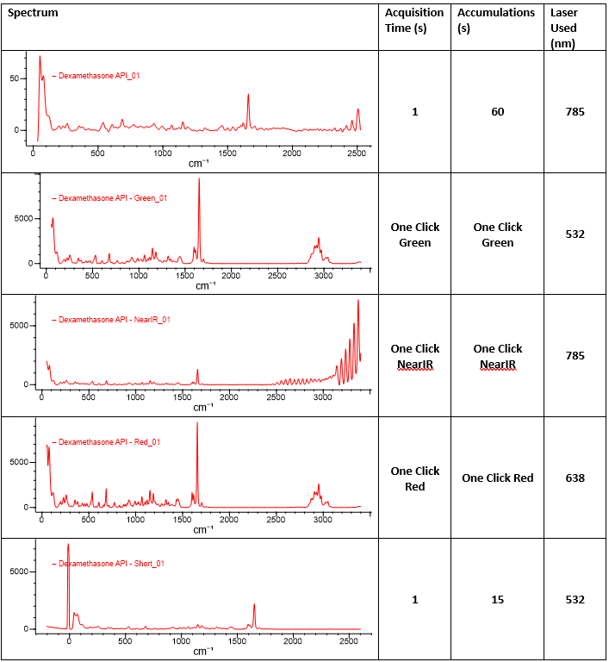
Dexamethasone API Spectra

Slide 3
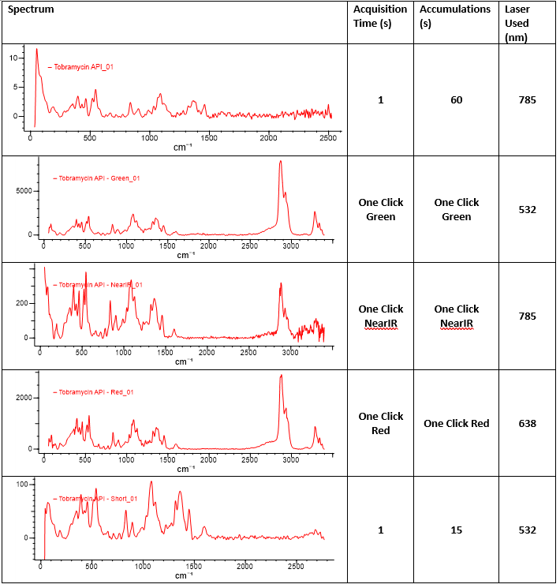
Tobramycin API Spectra

Slide 4
Spectral Analysis of API in Gel Matrix
Tobramycin spectrum was taken from best case scenario particle

Slide 5
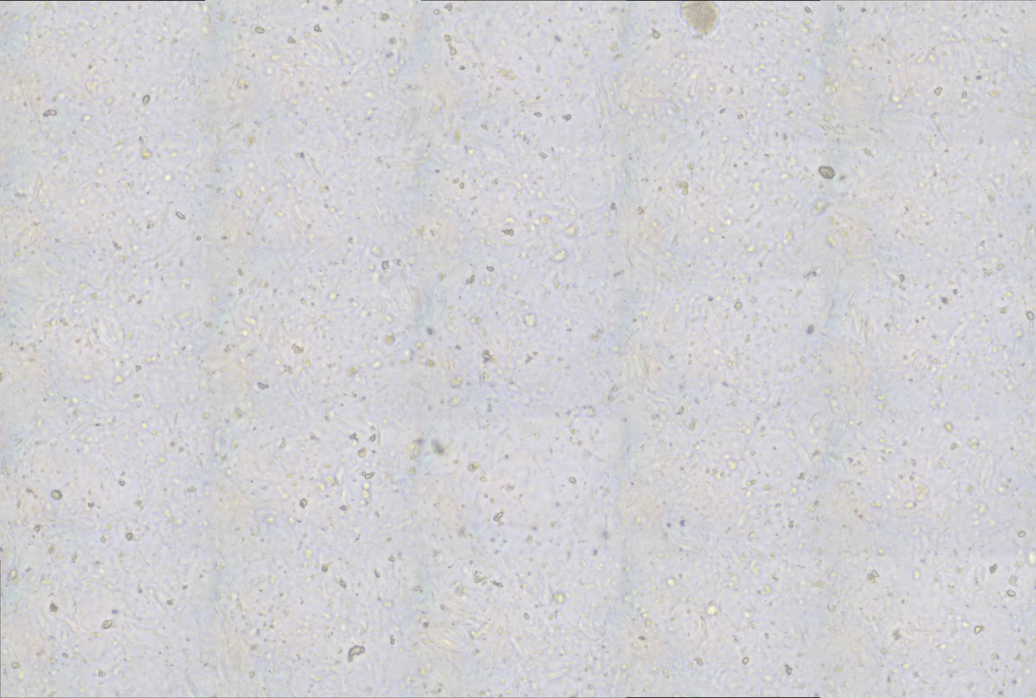
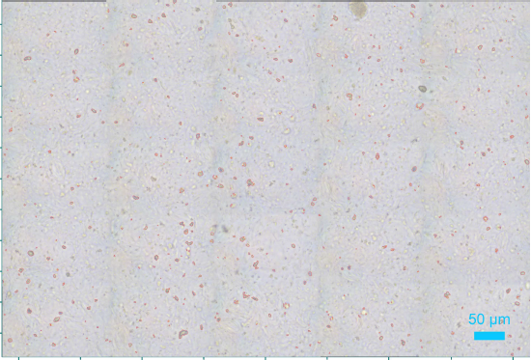
ParticleFinder Analysis (Triangle Autothresholding) 5x5 Mosaic of RLD 50X Lot: VU145A

Slide 6
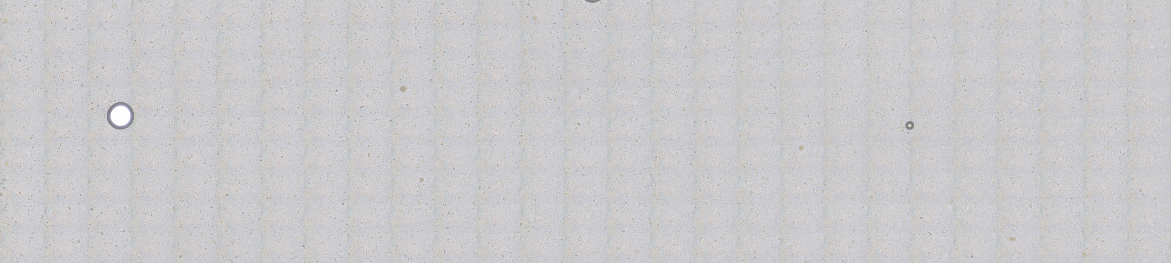
4.5 mm x 1.0 mm Mosaic RLD 50X Lot: VU145A

Slide 7
Settings for analysis
Parameter | Parameter setting
Acquisition Time (s) | 1
Accumulation | 15
Range | Off
Autofocus | At all XY pixels
SWIFT | Off
Autoexposure | Off
Spike Filter | Multiple Accum.
Delay Time (s) | 0
Binning | 1
Readout mode | Signal
DeNoise | Lite
ICS correction | On
Dark correction | Off
Inst Process | On
Detector Gain | Best Dynamic
Detector ADC | 50 kHz HS
Detector temperature | -75.01
Instrument | XploRA Plus
Detector | Synapse Plus
Objective | X50_VIS_LWD_DF
Grating | 1200
Filter | 10%
Laser | 532nm_Edge
Spectro (cm⁻¹) | 1400.00
Slit | 50
Hole | 100
Illuminator | Dark field
E-Cal_Neon | 0
Using a prefilter of Diameter ≤ 2.00 um to increase the robustness of spectra attained from analysis.
Using an “open” morphological filter to increase accuracy of sizing of particles.
Using these settings while targeting 1000 particles. An average run can take ~ 14-16Hrs.

Slide 8
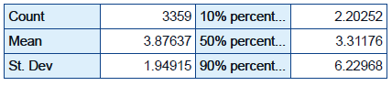
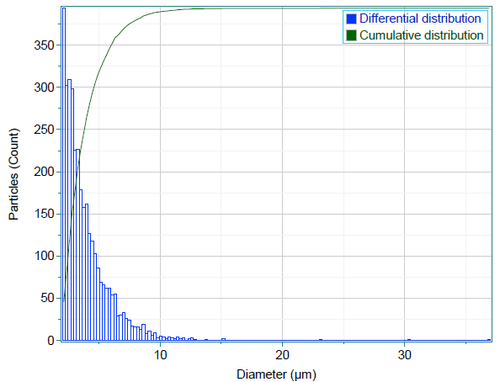
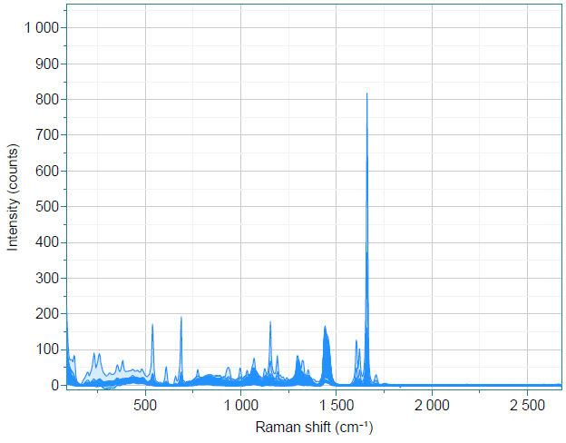
RLD Analysis of 1000 particles Total Particle Results
ELN Reference: 250429-0072
All spectra

Slide 9
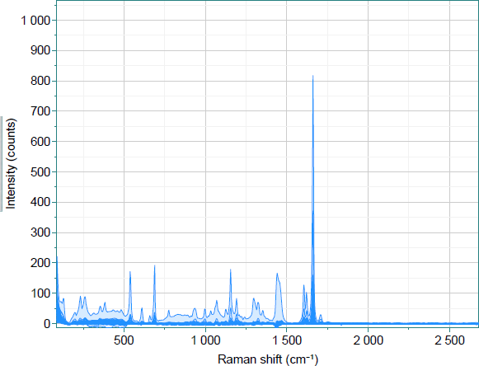
Analysis by spectral subtraction
ELN Reference: 250429-0072
All spectra with gel subtracted

Slide 10
Cursor Height Analysis of the peak located between 1635-1685 cm⁻¹
Cursor value ≥ 3.00 is determined to be Dexamethasone
2.00 < Cursor value < 3.00 is determined to be unknown
0.01 < Cursor value ≤ 2.00 is determined to be Non-Dexamethasone

Slide 11
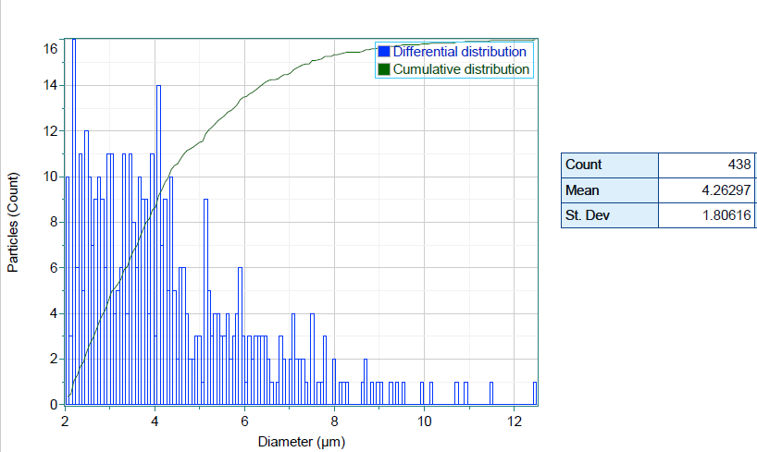
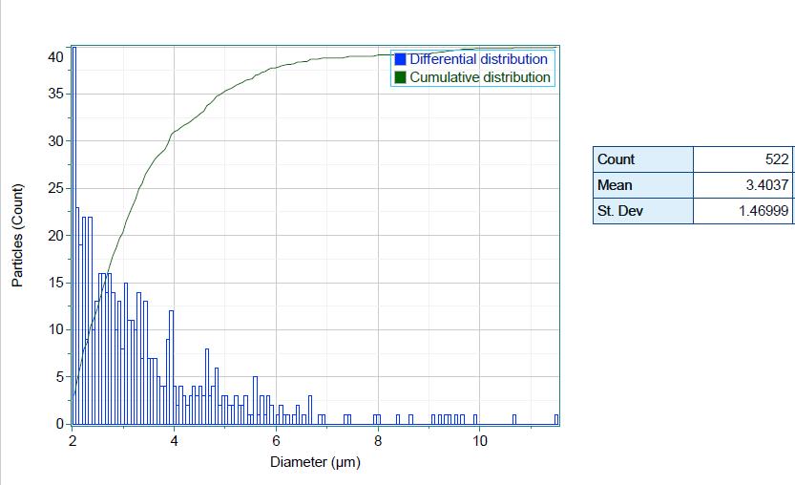
ELN Reference: 250429-0072
1000 Particle analysis
Non-Dexamethasone
Dexamethasone
Total
40 particles classified as unknown

Slide 12
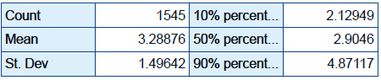
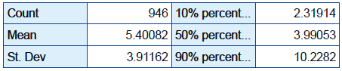
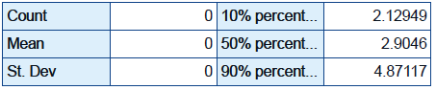
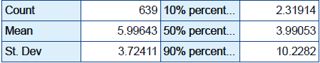
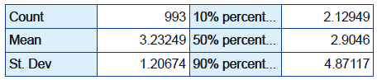
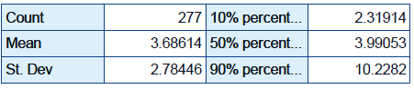
ELN Reference: 250430-0049
ELN Reference: 250430-0049
Tobramycin containing Placebo
Lot:DGO-25A-114P
Dexamethasone containing Placebo
Lot:DGO-25A-117P
Total
Total
Dexamethasone
Dexamethasone
Non-Dexamethasone
Non-Dexamethasone

Slide 13
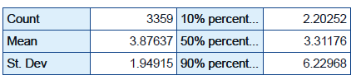
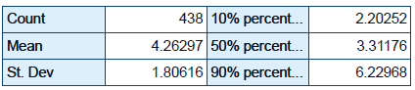
Horiba Reporting Results Trouble shooting
Dn statistics will not update when excluding particles
For Total, Dexamethasone and Non-Dexamethasone data can be exported to calculate and report area, diameter, ellipse ratio, circularity, convexity, elongation.

